Slide 1
Protecting The User Passwords At Rest

Slide 2
Unique Idea(Solution)
Our solution focuses on enhancing the user experience and security of file encryption and decryption through the following innovative features :
Multi-Platform Compatibility:
Extend the application to support multiple platforms (Windows, macOS, Linux) using a cross-platform GUI framework like Qt or Kivy. This ensures users can encrypt and decrypt their files consistently across different operating systems.
2.Enhanced Security Measures:
Implement biometric authentication (fingerprint or face recognition) alongside passphrase entry for decryption on supported devices (e.g., laptops with fingerprint sensors or smartphones with Face ID). This dual-layer authentication enhances security without compromising user convenience.

Slide 3
3.Real-time File Monitoring: Provide real-time monitoring of encrypted files for unauthorized access attempts. Implement alerts or notifications when unauthorized access is detected, ensuring users are promptly informed of any potential security breaches.
4.Batch Processing and Performance Optimization:
Optimize file encryption and decryption performance for large directories through parallel processing techniques or GPU acceleration where applicable. Implement batch processing options to handle multiple files concurrently, reducing encryption and decryption times significantly
5.Secure File Sharing Mechanism:
Develop a secure file sharing feature that generates time-limited decryption keys or one-time use links. This enables users to securely share encrypted files with specific recipients without exposing the passphrase or compromising the file's security.
6.User-friendly Interface Enhancements:
Enhance the user interface with intuitive visual indicators of encryption status, progress bars for large file operations, and detailed logs for transparency. Implement drag-and-drop functionality for easier file selection and operations

Slide 4
Impact:
Enhanced Security: By integrating biometric authentication and real-time monitoring, our solution ensures robust protection against unauthorized access.
Improved Usability: Multi-platform support and cloud integration simplify file encryption workflows, making it accessible and efficient for users across diverse environments.
Scalability: Optimized performance and batch processing capabilities accommodate large-scale encryption needs, catering to both individual and enterprise users.
Conclusion: Our innovative approach not only strengthens file security but also enhances user experience through seamless integration, advanced authentication methods, and optimized performance, ensuring confidentiality and integrity in file encryption and decryption operations across various platforms and cloud environments.

Slide 5
>FEATURES
1.AES Encryption: Utilizes AES (Advanced Encryption Standard) with a 256-bit key size for robust data encryption, ensuring confidentiality of files and directories.
2.Passphrase-based Encryption: Allows users to securely encrypt files and directories using a passphrase, ensuring only authorized users can decrypt them.
3.File and Directory Handling:
Supports encryption and decryption of both individual files and entire directories.
Preserves directory structure during encryption and restores it during decryption, maintaining organizational integrity.
4.Key Management:
Generates random file encryption keys for each encrypted file, enhancing security.
Derives a secure key from the user-provided passphrase and a randomly generated salt using PBKDF2 for encryption key encryption.
5.Secure Storage of Encrypted Keys:
Encrypts file encryption keys using AES-CFB mode with a key derived from the passphrase and stores them alongside the encrypted data.
Ensures the integrity of encrypted file keys using HMAC-SHA256 for authentication.
6.Graphical User Interface (GUI):
Provides a user-friendly GUI using tkinter, allowing easy file selection, passphrase input, and interaction with encryption and decryption functionalities.
Supports browsing for files and folders, simplifying user interaction with the application.

Slide 6
7.Asynchronous Operations:
Executes encryption and decryption operations asynchronously using threads, ensuring the GUI remains responsive during file processing.
Displays loading indicators and completion messages to keep users informed about the progress and outcome of operations.
8.File System Integration:
Seamlessly integrates with the local file system to encrypt and decrypt files and directories, ensuring compatibility and ease of use on different platforms.
9.Cross-Platform Compatibility:
Supports deployment across multiple operating systems (Windows, macOS, Linux) due to the cross-platform capabilities of the tkinter GUI framework.
These features collectively ensure that users can securely encrypt their sensitive files and directories, manage encryption keys effectively, and seamlessly decrypt them when needed, all within an intuitive and responsive user interface.

Slide 7
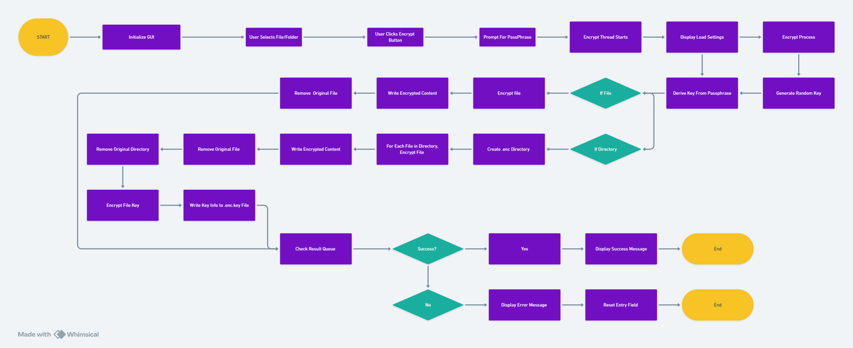
PROCESS FLOW FOR ENCRYPTION
ENCRYPTION image link
encryption

Slide 8
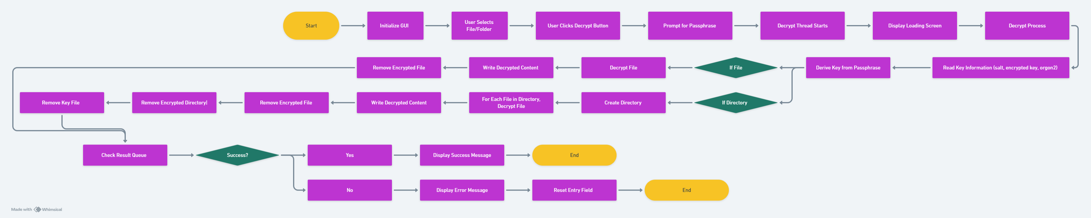
FOR DECRYPTION
DECRYPTION image link
decryption

Slide 9
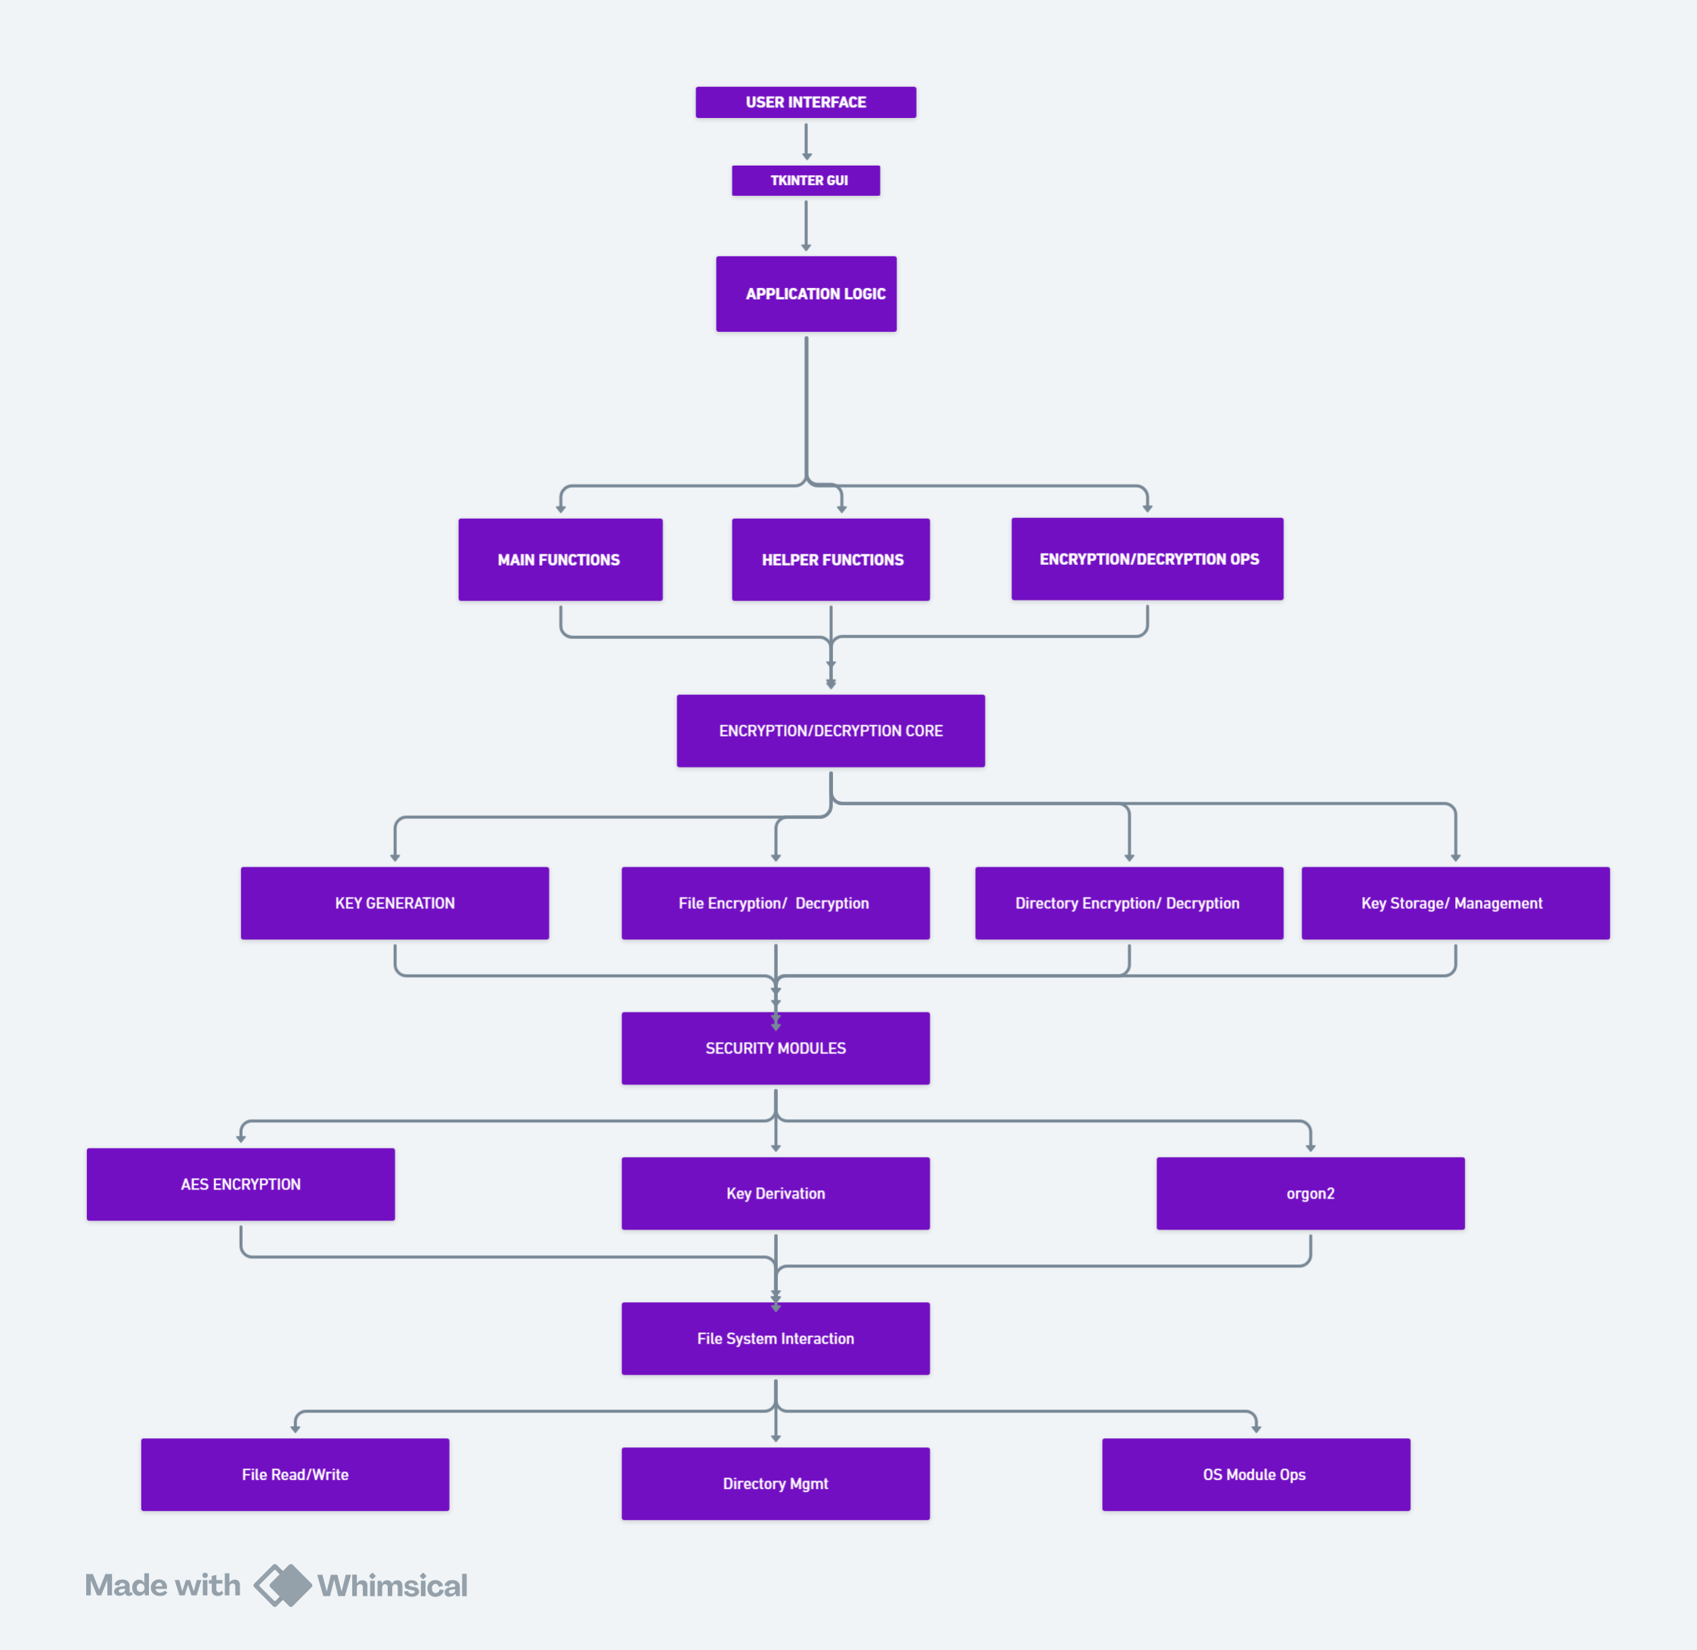
ARCHITECTURE DIAGRAM
Architecture image link
Architecture

Slide 10
TECHNOLOGIES USED
1.Python:
The primary programming language used to develop the application.
2.tkinter:
Description: Standard GUI library for Python.
Usage: Provides the graphical user interface (GUI) for the application, including windows, buttons, dialogs, and input fields.
3.os:
Description: Standard library module for interacting with the operating system.
Usage: Handles file and directory operations such as checking if a file exists, creating directories, and joining file paths.
4.shutil:
Description: Standard library module for high-level file operations.
Usage: Handles directory operations such as removing directories and copying files.

Slide 11
json:
Description: Standard library module for parsing and manipulating JSON data.
Usage: Stores and retrieves key information in JSON format for encrypted files.
time:
Description: Standard library module for time-related functions.
Usage: Adds delays (e.g., to allow time for directory operations to complete).
threading:
Description: Standard library module for threading.
Usage: Runs encryption and decryption operations in separate threads to keep the GUI responsive.
queue:
Description: Standard library module for creating and managing queues.
Usage: Manages communication between threads and the main GUI thread.

Slide 12
Crypto (PyCryptodome):
Description: Third-party library for cryptographic functions.
Usage:
AES: Provides AES encryption and decryption functionalities.
Random: Generates random bytes for keys and initialization vectors.
Protocol: Provides the PBKDF2 key derivation function.
Hash: Provides HMAC for message authentication and integrity verification.
HMAC:
Description: Part of the PyCryptodome library.
Usage: Computes and verifies HMACs to ensure the integrity of encrypted data.

Slide 13
TEAM MEMBERS AND CONTRIBUTION
BUSIREDDY JAGADEESWAR REDDY - Linux File System Operations, Crypto Algorithms.
DOMMA ANIL KUMAR-PYTHON MODULES,GRAPHICAL USER INTERFACE

Slide 14
CONCLUSION:
The file encryption and decryption application developed using Python integrates a robust set of technologies to ensure secure and efficient handling of sensitive data. By leveraging the powerful AES encryption standard through the PyCryptodome library, the application guarantees the confidentiality and integrity of files and directories. The user-friendly graphical interface, built with tkinter, simplifies the process of selecting files or folders and managing encryption and decryption operations, making it accessible even to non-technical users.
Key features such as passphrase-based encryption, secure key management, and asynchronous operations enhance both the security and usability of the application. The implementation of HMAC for data integrity checks and PBKDF2 for secure key derivation further fortifies the application's defense against unauthorized access and tampering.

Slide 15
Through thoughtful integration of core Python libraries and effective use of threading for responsiveness, the application maintains a seamless user experience without compromising on performance. The comprehensive error handling and informative feedback mechanisms ensure users are well-guided throughout their interactions with the application.
Overall, this application stands as a reliable and secure solution for individuals and organizations looking to protect their sensitive files and directories. Its design and implementation reflect a balanced emphasis on security, usability, and performance, making it a valuable tool in the realm of data protection

Slide 16



